Slide 1
Unit 3 LH 3

Slide 2
Circle Algorithm
What is Circle ?
Similarly to the case with lines, there is an incremental algorithm for drawing circles – the mid-point circle algorithm
In the mid-point circle algorithm we use eight-way symmetry so only ever calculate the points for the top right eighth of a circle, and then use symmetry to get the rest of the points

Slide 3
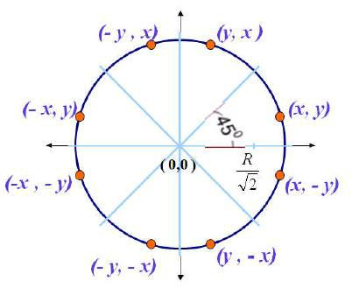

Slide 4
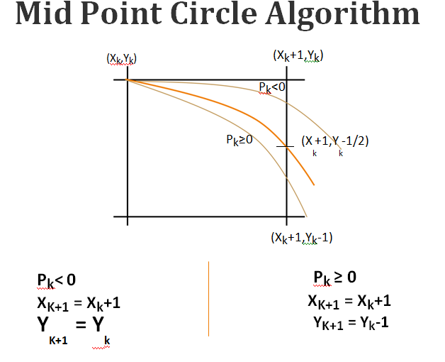

Slide 5
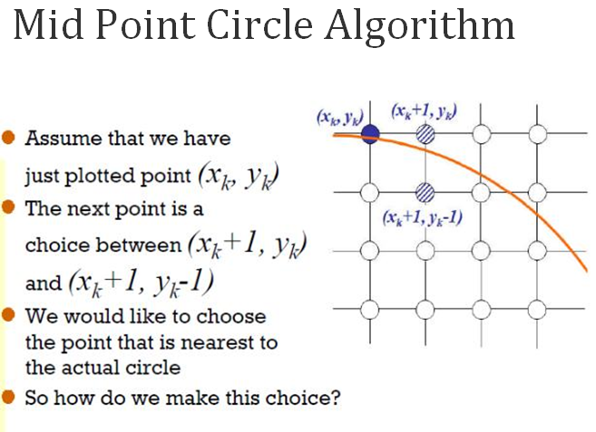

Slide 6
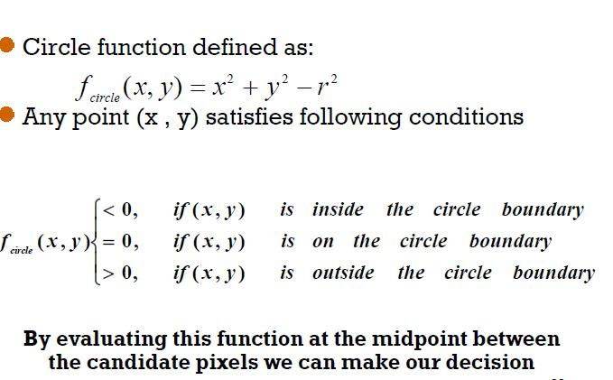
Midpoint Circle Algorithm

Slide 7
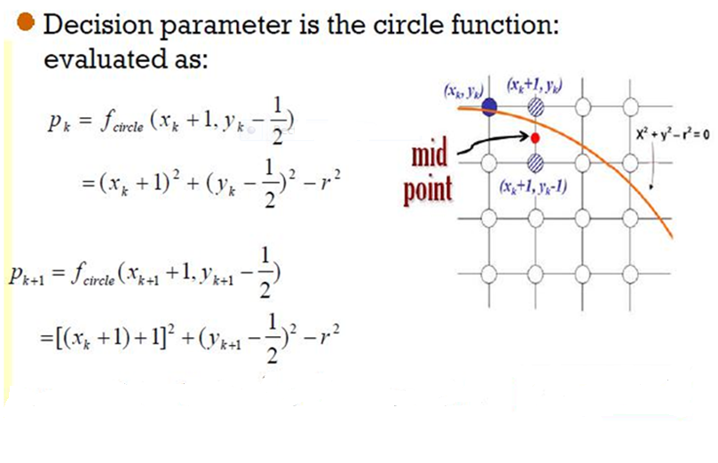

Slide 8
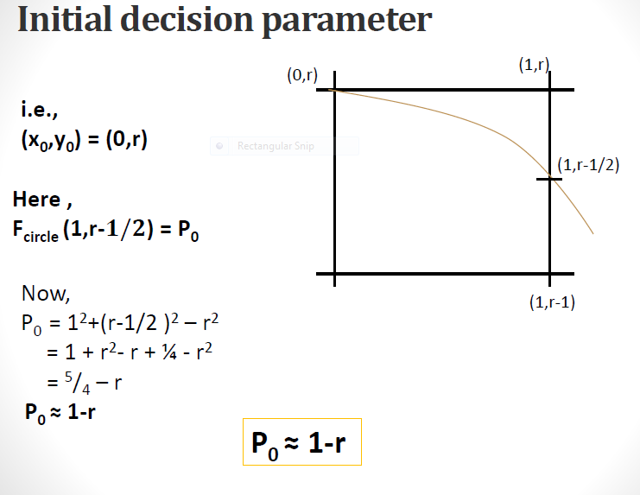

Slide 9
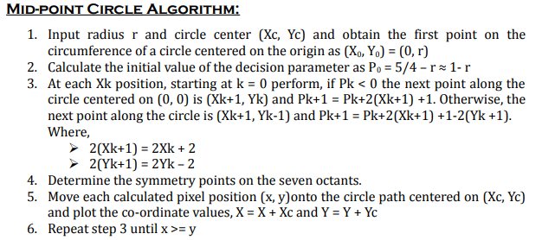

Slide 10
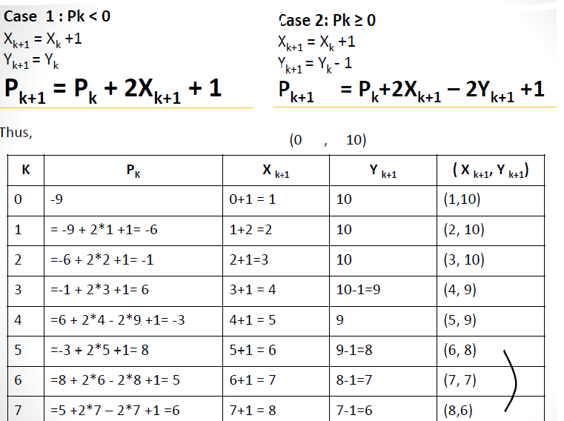
Digitize a circle with radius r= 10

Slide 11
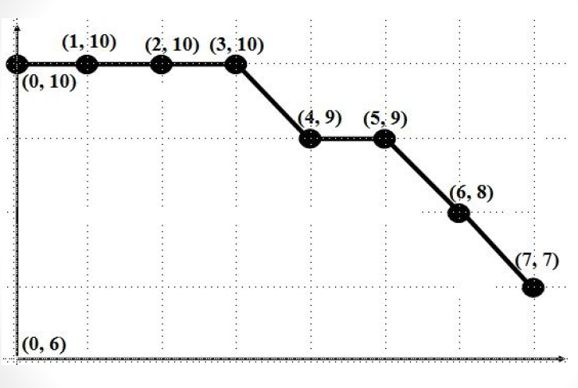

Slide 12
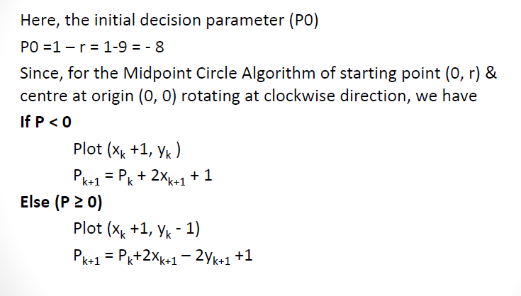
Digitize a circle with radius 9 and center at (6,7)

Slide 13
